Slide 1

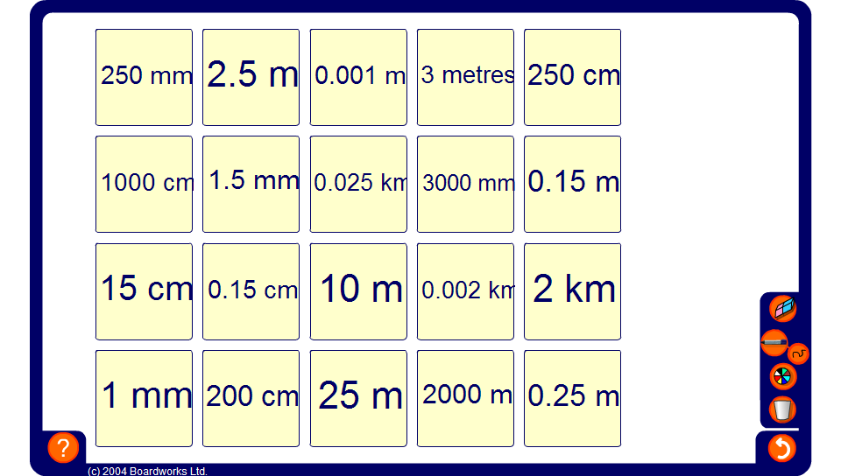


Converting metric units
Notes:
Practice matching metric units of length.

